Slide 1

A Biological Vision Inspired Framework for Image
Enhancement in Poor Visibility Conditions
IEEE TRANSACTIONS ON IMAGE PROCESSING

Slide 2
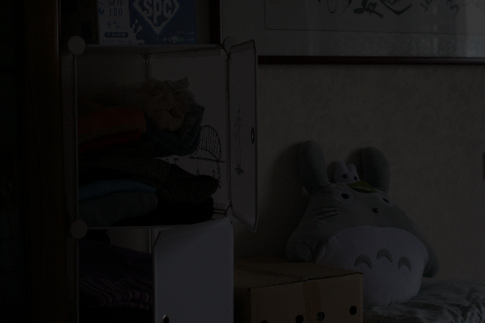

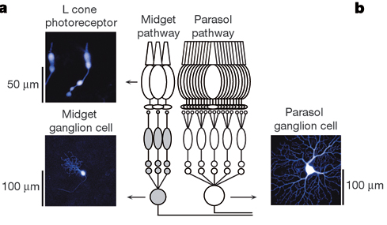
Introduction
The images captured under low-light or nighttime conditions usually suffer the poor visibility and weak contrast. One interesting issue is how the human visual system (HVS) can efficiently resist various visual disturbances in complex visual scenes and maintain highly robust visual processing.
Parallel information processing channels in the retina
playimportant roles in further visual processing. Basically,
the input visual signals are processed in the retina
with two types of cells, i.e., Midget cells and Parasol
cells.

Slide 3
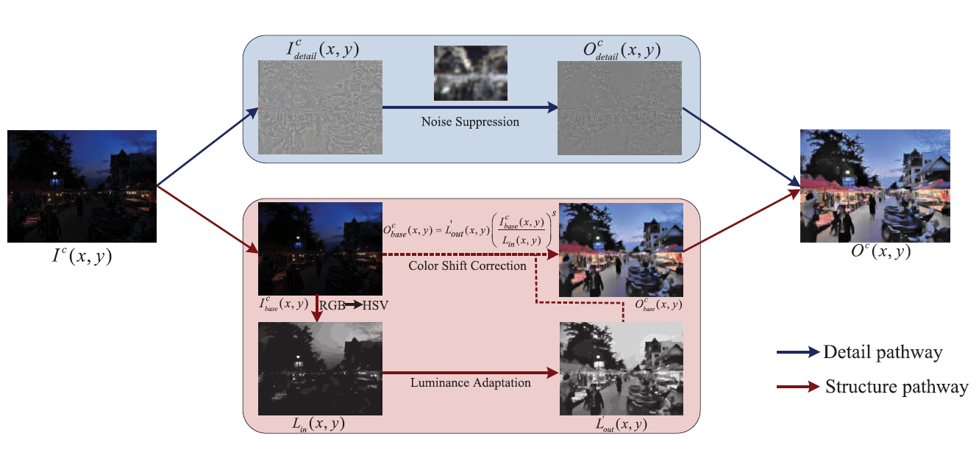
Proposed framework
Notes:
从图1可以看出，在三个基准数据集和两个不相关的自然数据集上包含可检测灰色像素的图像的百分比

Slide 4
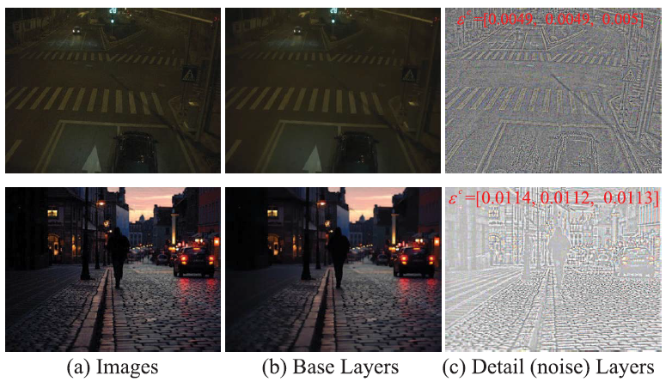

Slide 5
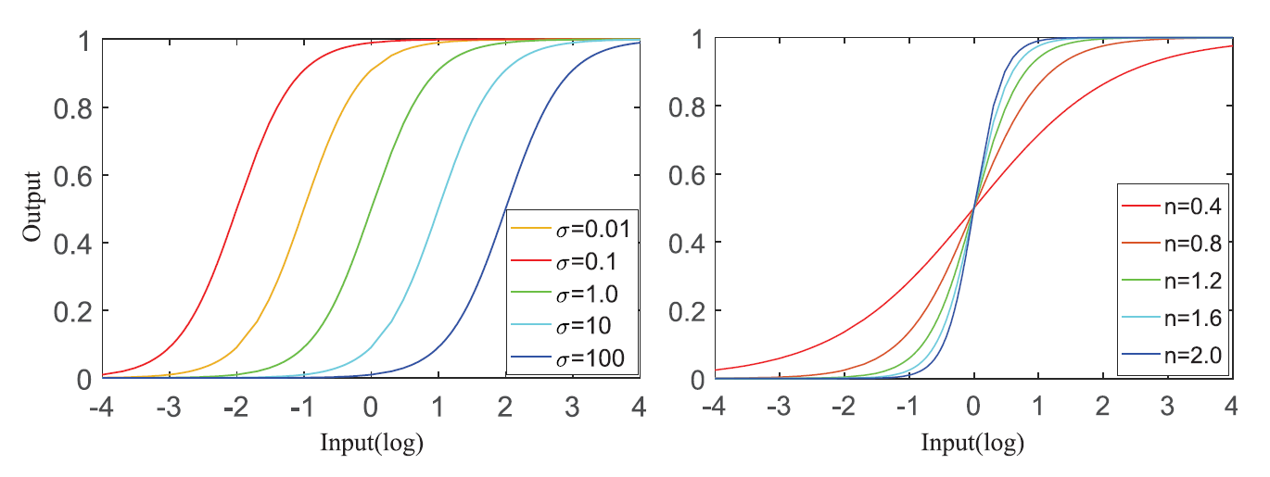
Algorithm workflow
Notes:
Figure 3 shows the flowchart of the proposed algorithm

Slide 6
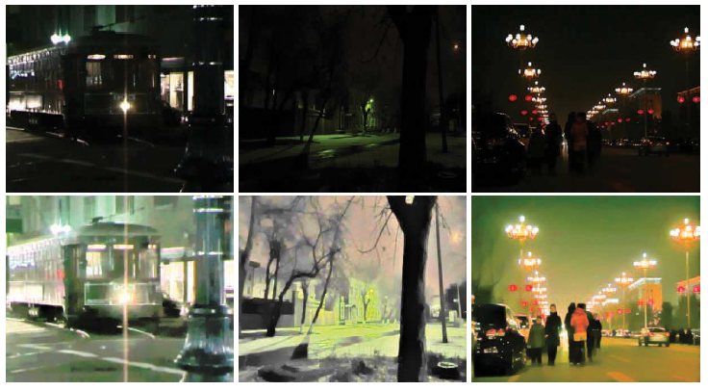
Experimental result
Notes:
Extensive evaluations on benchmark datasets indicate
that the proposed method with grey pixels can obviously
outperform the models with the grey-world and grey-edge
information

Slide 7
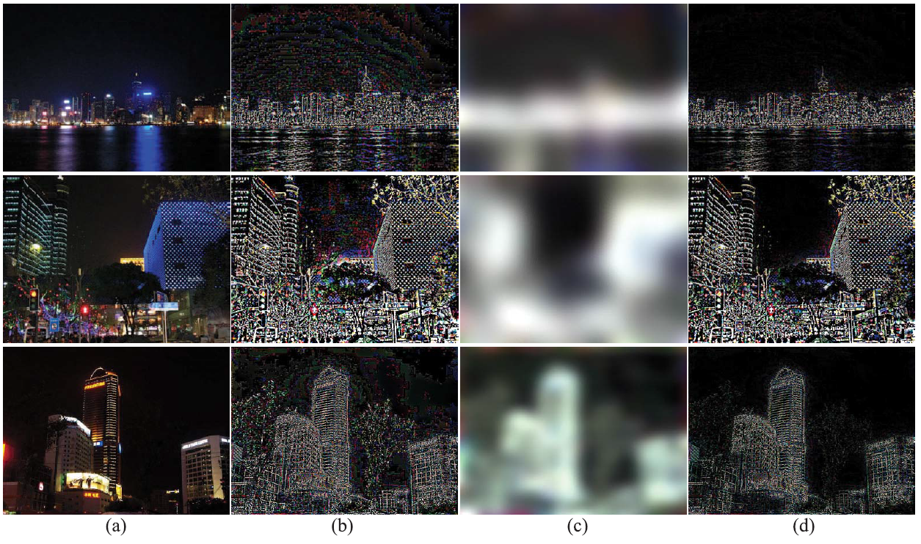
Use the model for underwater image effects

Slide 9

Thank you!
THANK YOU FOR YOUR CAREFUL LISTENING

